Slide 1
GOBI: From Time series Data to Causal Relationships (Application to Weather Factors and Dengue Incidence)
Olive R. Cawiding
2024.01.19

Slide 2

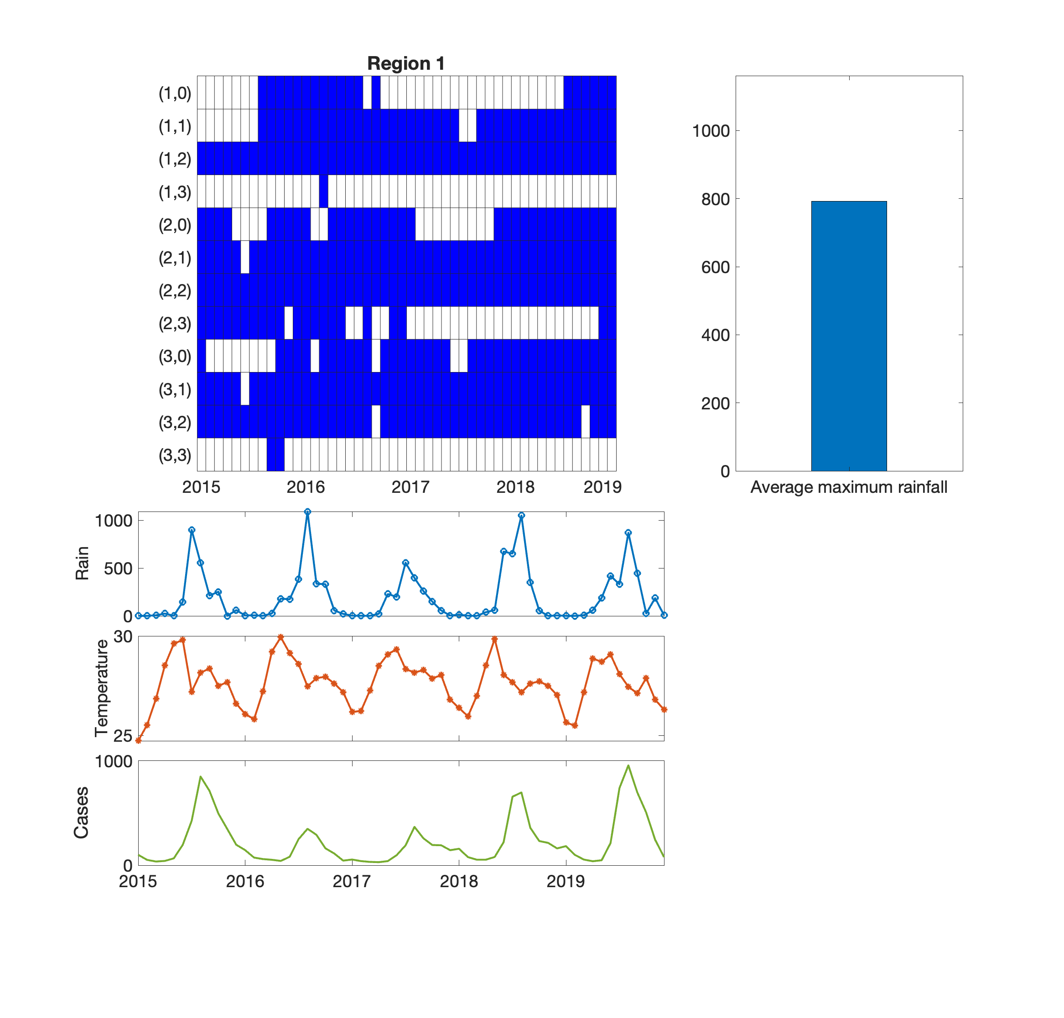

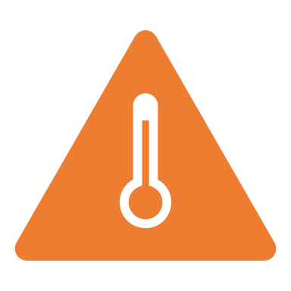
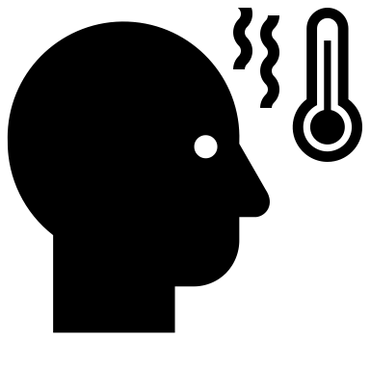
How do we infer regulatory relationships from time series data?
Time series data
?
?
?
Notes:
Good morning. My name is Olive R. Cawiding. I am a PhD student in the Department of Mathematical Sciences. Today I will talk about investigating the causal relatioships between weather factors and dengue incidence in the Philippines. The main problem I addressed here is when given a time series data of weather factors and dengue incidence data, how are we able to infer regulatory relationships between them?

Slide 3
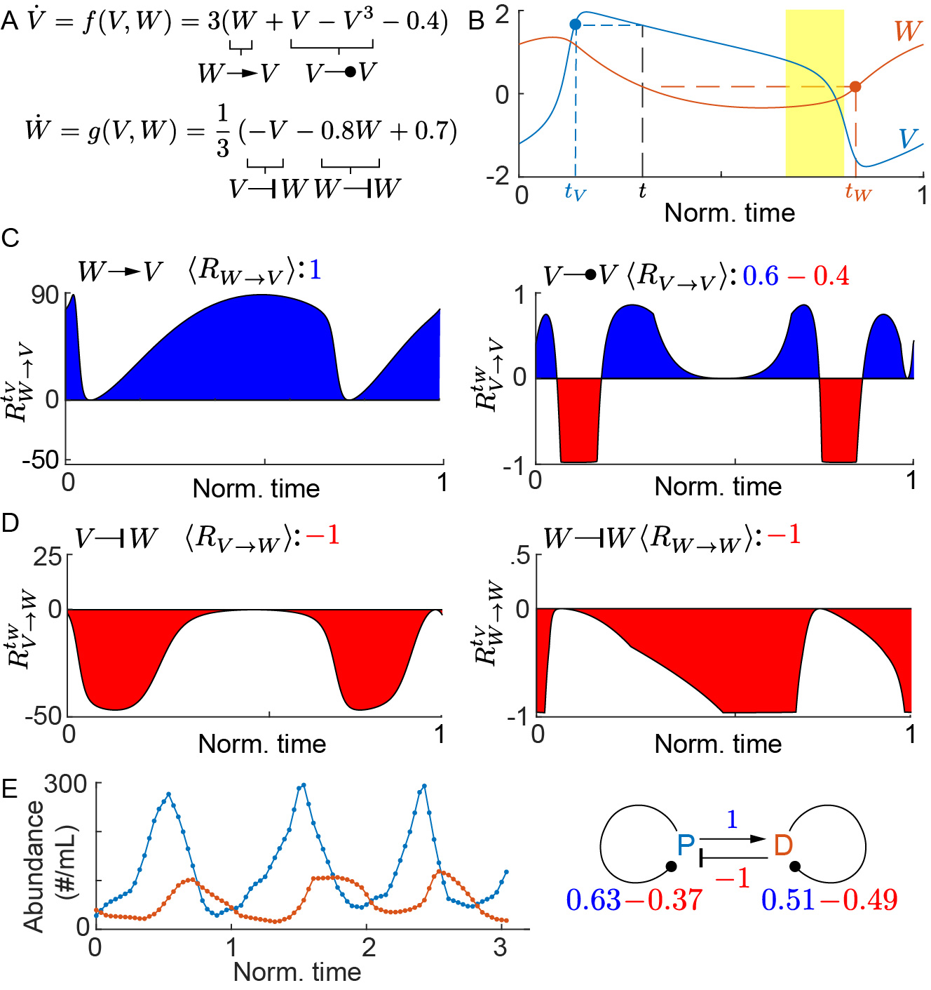

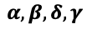
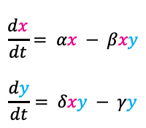
Some well-known inference methods
MODEL-FREE METHODS
- Granger Causality (GC) : 2003 Nobel Prize in Economic Sciences
- Convergent Cross Mapping (CCM) : Sugihara et al., 2012, SCIENCE, over 1500 citations
MODEL-BASED METHODS
Time-series data
B
$$α, β, δ, γ$$
Parameter estimation
A
C
$$\frac{dx}{dt}= αx − βxy$$
$$\frac{dy}{dt}= δxy − γy$$
synchrony
Indirect effect
False predictions in the presence of synchrony and indirect effect!
Strong dependence on a chosen model
(limited applicability)
Need: a method that is accurate and broadly applicable to systems of the form:
$\frac{dY}{dt}=f(X_{1}, X_{2}, …, X_{N})$
General ODE-based Inference (GOBI)* is broadly applicable & accurate.
*Park, S.H., Ha, S. & Kim, J.K., Nat Commun, 2023
Notes:
There have been many famous causation methods throughout the years. Among the model-free methods include Granger causality which has won a Nobel prize in economic sciences and Convergent Cross mapping which has been very commonly used with over 1500 citations. The problem with these methods is that when there is a presence of synchrony, that is, if two time series have the same period, these methods tend to always detect a causation between them even if they are completely unrelated. Another problem is that these methods often cannot distinguish between direct and indirect effects. For example, if the relationship between the variables A, B, and C are these black arrows only, that is, A regulates B and B regulates C, they detect a direct relationship between A and C. So the problem with these methods are that they give false positive predictions. It is also possible to use model-based methods. For example if we have the time series data given by this, we can construct a model that can possibly represent its dynamics, perform parameter estimation to get the best parameter estimates that fit the data, and then infer the regulation type between the two variables. There are two problems with this method. First, the results can be very dependent on a given model, that is, if we use a time series data that is not governed by these equations, then we would get inaccurate results. Second, parameter estimation can be computationally costly, specially if the number of unknown parameters increase. What can be a solution to this problem? We can use a model-based method using a flexible model. By flexible model, we mean that the method we should use should be applicable to a general ODE model with multiple components. The general ODE-based inference (GOBI) is broadly applicable and accurate and addresses the problems identified from the well-known methods.

Slide 4
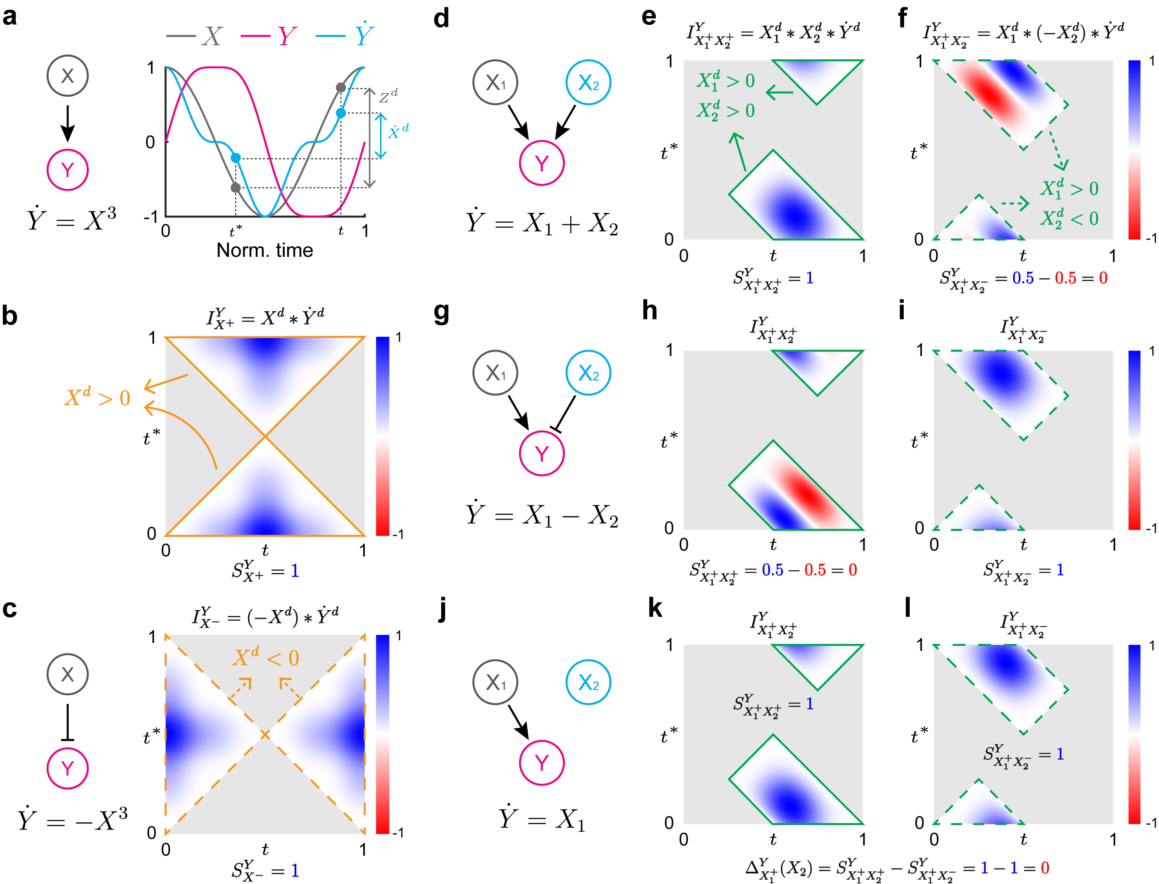
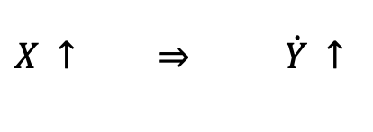
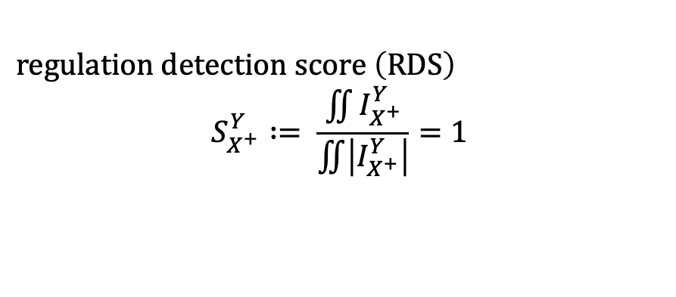
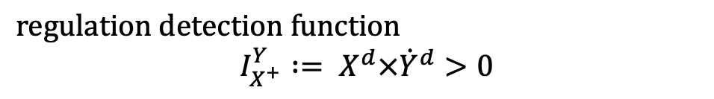
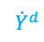
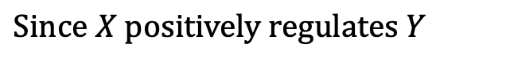
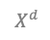
Inferring 1D positive regulation with GOBI
$$Since X positively regulates Y$$
$$X^{d}$$
$X ↑$ $\dot{Y} ↑$
$${\dot{Y}}^{d}$$
$If X^{d}=X_{ }\left(t\right)−X_{ }\left(t^{∗}\right)>0, then {\dot{Y}}^{d}=\dot{Y}\left(t\right)−\dot{Y}\left(t^{∗}\right)>0$.
$$regulation detection function$$
$I_{X^{+}}^{Y}∶= X^{d}×{\dot{Y}}^{d}>0$
$$regulation detection score \left(RDS\right)$$
$$S_{X^{+}}^{Y}∶= \frac{\iint{I_{X^{+}}^{Y}}}{\iint{\left|I_{X^{+}}^{Y}\right|}}=1$$
Park, S.H., Ha, S. & Kim, J.K., Nat Commun, 2023
Notes:
From now on, I will describe how GOBI is applied to infer relationships between variables. We start with this simple example. Suppose we have two time series X, the gray line, and a time series Y, the pink line. We also see here the plot of the derivative of Y. If the underlying relationship between X and Y is that X positively regulates Y, then an increase in X must imply an increase in the derivative of Y. That is, if we take two values of X at two different time points and the difference is positive, then the corresponding difference in Y dot must also be positive. Then, we can infer the regulation from the regulation detection score, given by I. Since Xd is positive, then Y dot is also positive and the product will always be positive. We can quantify this by dividing by its normalized integral, that we will call the regulation detection score, so that it is always equal to 1.

Slide 5
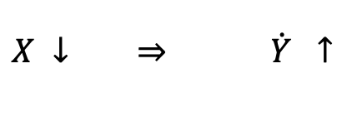
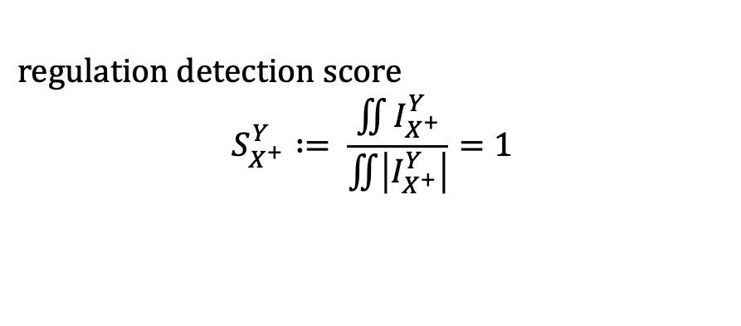
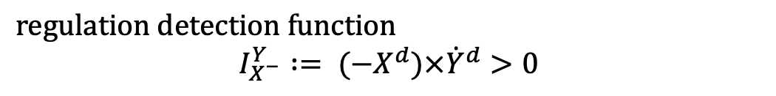
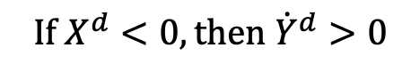
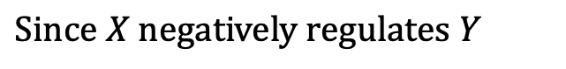
Inferring 1D negative regulation with GOBI
$$Since X negatively regulates Y$$
$X ↓$ $\dot{Y} ↑$
$$If X^{d}<0, then {\dot{Y}}^{d}>0$$
$$regulation detection function$$
$$I_{X^{−}}^{Y}∶= {(−X}^{d})×{\dot{Y}}^{d}>0$$
$$regulation detection score$$
$$S_{X^{+}}^{Y}∶= \frac{\iint{I_{X^{+}}^{Y}}}{\iint{\left|I_{X^{+}}^{Y}\right|}}=1$$
Park, S.H., Ha, S. & Kim, J.K., Nat Commun, 2023
Notes:
Similarly, if X negatively regulates Y, then this means that a decrease in X will correspond to an increase in Y dot. So that our regulation detection function is replaced by this, Xd is always negative, and so I is always positive. As a results, the regulation detecion score is always 1.

Slide 6
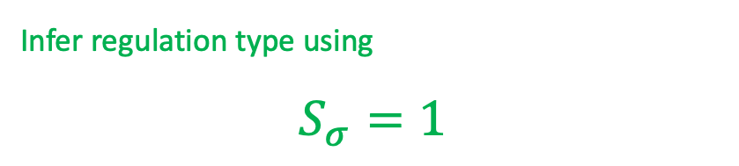
Inferring 2D regulations using GOBI
The regulation detection function is not always positive if it does not match the actual regulation type.
Infer regulation type using
$$S_{σ}=1$$
Park, S.H., Ha, S. & Kim, J.K., Nat Commun, 2023
Notes:
This can be extended in the 2 dimensional case, So suppose we have two variables X1 and X2 positively regulating Y. We can see that if this happens, I will always still be positive when we check for the correct regulation type. However if we we check the regulation detection function for + regulation from X1 and - regulation from X2, I will not always be positive. It is the same for this ecxample where X1 positively regulates Y and X2 negatively regulates Y, the correct regulation detection function will give us a positive value so that the score is always 1, however if the regulation detection function is inaccurate, we I will not be always positive. In other words, the regulation detection function is not always positive if it does not match the actual regulation type. So that we can determine the regulation type if S is 1.

Slide 7
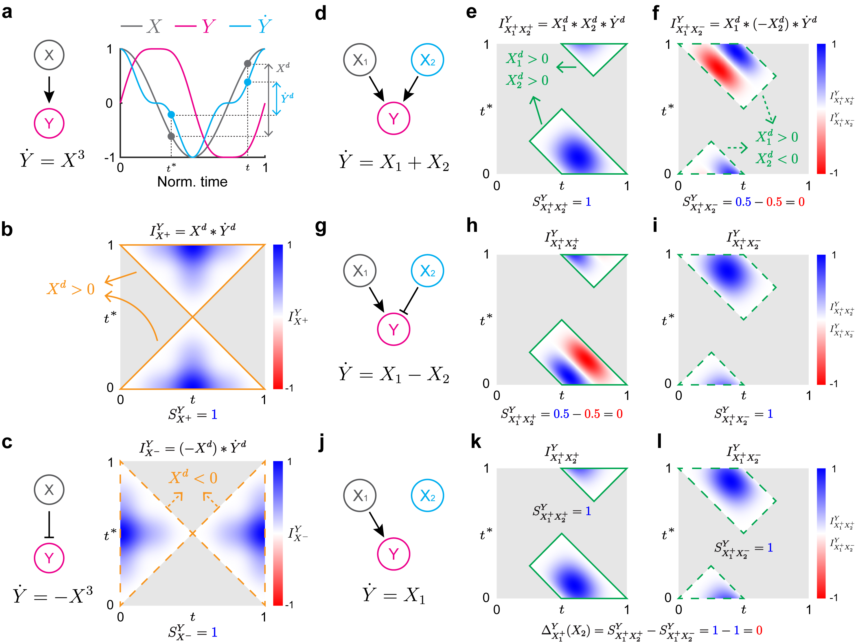
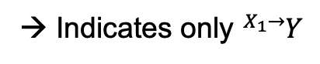
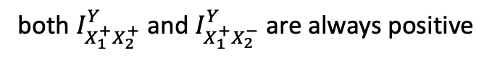
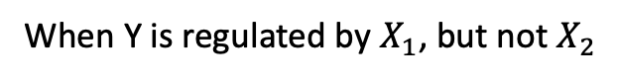
Regulation-delta function removes false positive predictions
When Y is regulated by $X_{1}$, but not $X_{2}$
both $I_{X_{1}^{+}X_{2}^{+}}^{Y}$ and $I_{X_{1}^{+}X_{2}^{−}}^{Y}$ are always positive
→ Indicates only ${}_{ }^{X_{1}→}Y$
Park, S.H., Ha, S. & Kim, J.K., Nat Commun, 2023
Notes:
An additional case is that X1 positively regulates Y and X2 does not regulate Y at all. In this case we see that both regulation detection functions are positive regardless of X2. Then both regulation scores are equal to 1. In this case, we can use a filtering test called the regulation-delta function, or simply the delta test. What we do is just subtract the two regulation scores and if it is equal to zero, then this means that the conditions do not indicate the presence of these two regulation types.

Slide 8
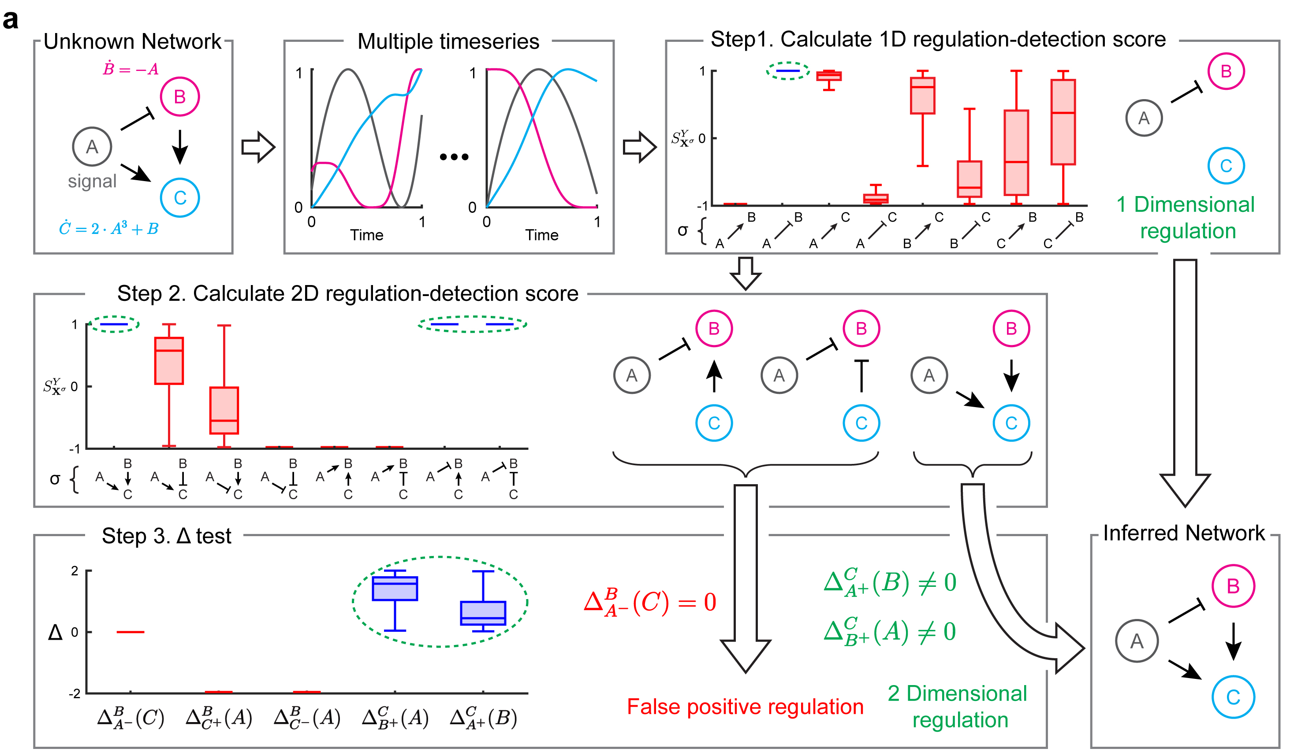
Framework for inferring regulatory network
Park, S.H., Ha, S. & Kim, J.K., Nat Commun, 2023
Notes:
So to summarize this is the framework for inferring a regulatory network.

Slide 9
Regulation detection score is not always 1 in the presence of noise.
True
False
Use thresholds ($S^{thres}$) in the presence of noise to distinguish between true and false regulations.
$$S^{thres}=0.9−0.005 × (noise level)$$
Park, S.H., Ha, S. & Kim, J.K., Nat Commun, 2023
Notes:
When the data is very noisy, it is possible that the regulation score is not always 1. Let’s take a look at this example. Here the true regulation is A negatively regulates B and a false regulation is A positively regulates C. If the noise is ignored, then there is a possibility of incorrectly detecting a false regulation. However if the noise is incorporated, as the noise is increased the difference between the true and false regulations become more evident. In this case, we should set some threshold values for the score that we will accept as true regulation.

Slide 10
Surrogate test in the presence of noise removes indirect regulation.
Park, S.H., Ha, S. & Kim, J.K., Nat Commun, 2023
Notes:
In the presence of noise, since score is not always equal to 1, the delta test may not be equal to zero and will fail to distinguish the indirect regulations. In this case we use a surrogate test. We fix B and shuffle A many many times, and for each shuffling we compute the corresponding score, so that for the many shuffling, we get many regulation scores and we can generate this distribution. By doing this, we are destroying the dependence of C on A, so that if we compare the original value of the score of the unshuffled data to this distribution, if the p-value is less than some threshold, then there is actually a direct regulation. If there is no direct regulation, then the score is not significantly larger than the scores from the shuffled data.

Slide 11
Extended framework for inferring network from noisy data
Park, S.H., Ha, S. & Kim, J.K., Nat Commun, 2023

Slide 12
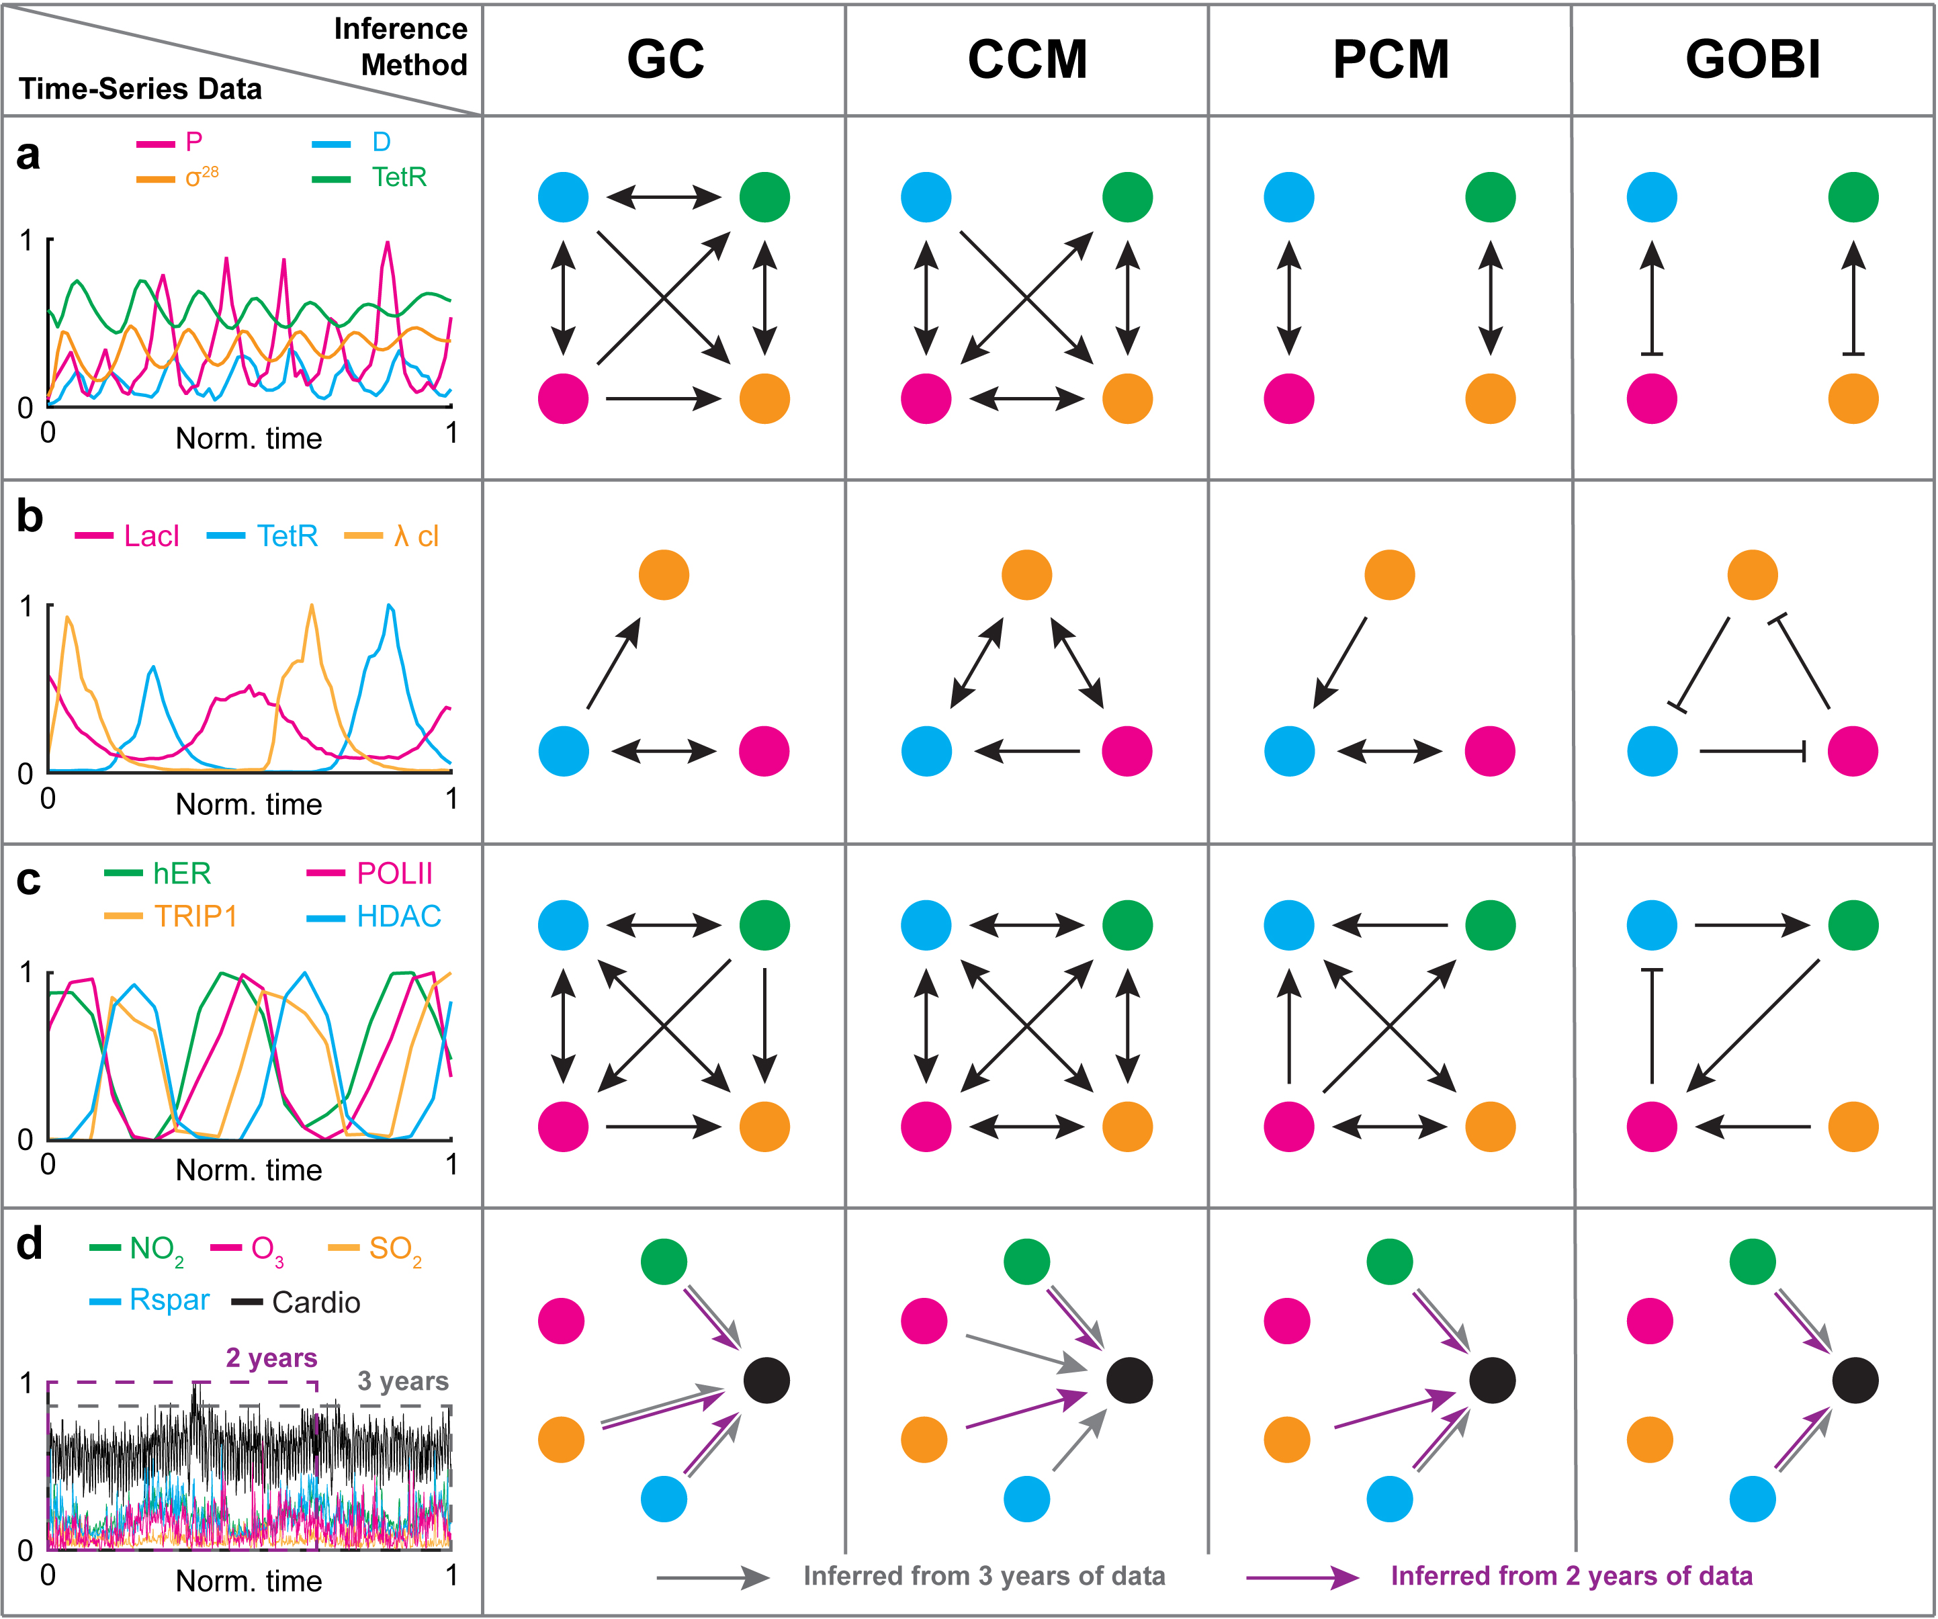
Comparison with other methods shows superiority of GOBI.
Actual regulatory network structure

Slide 13
We want to infer the relationship between weather variables and dengue incidence using only time series data from the Philippines.
Time series data
?
?
?
Notes:
Good morning. My name is Olive R. Cawiding. I am a PhD student in the Department of Mathematical Sciences. Today I will talk about investigating the causal relatioships between weather factors and dengue incidence in the Philippines. The main problem I addressed here is when given a time series data of weather factors and dengue incidence data, how are we able to infer regulatory relationships between them?

Slide 14
We want to infer the relationship between weather variables and dengue incidence using only time series data.
Time series data
?
GOBI
?
Notes:
Good morning. My name is Olive R. Cawiding. I am a PhD student in the Department of Mathematical Sciences. Today I will talk about investigating the causal relatioships between weather factors and dengue incidence in the Philippines. The main problem I addressed here is when given a time series data of weather factors and dengue incidence data, how are we able to infer regulatory relationships between them?

Slide 15
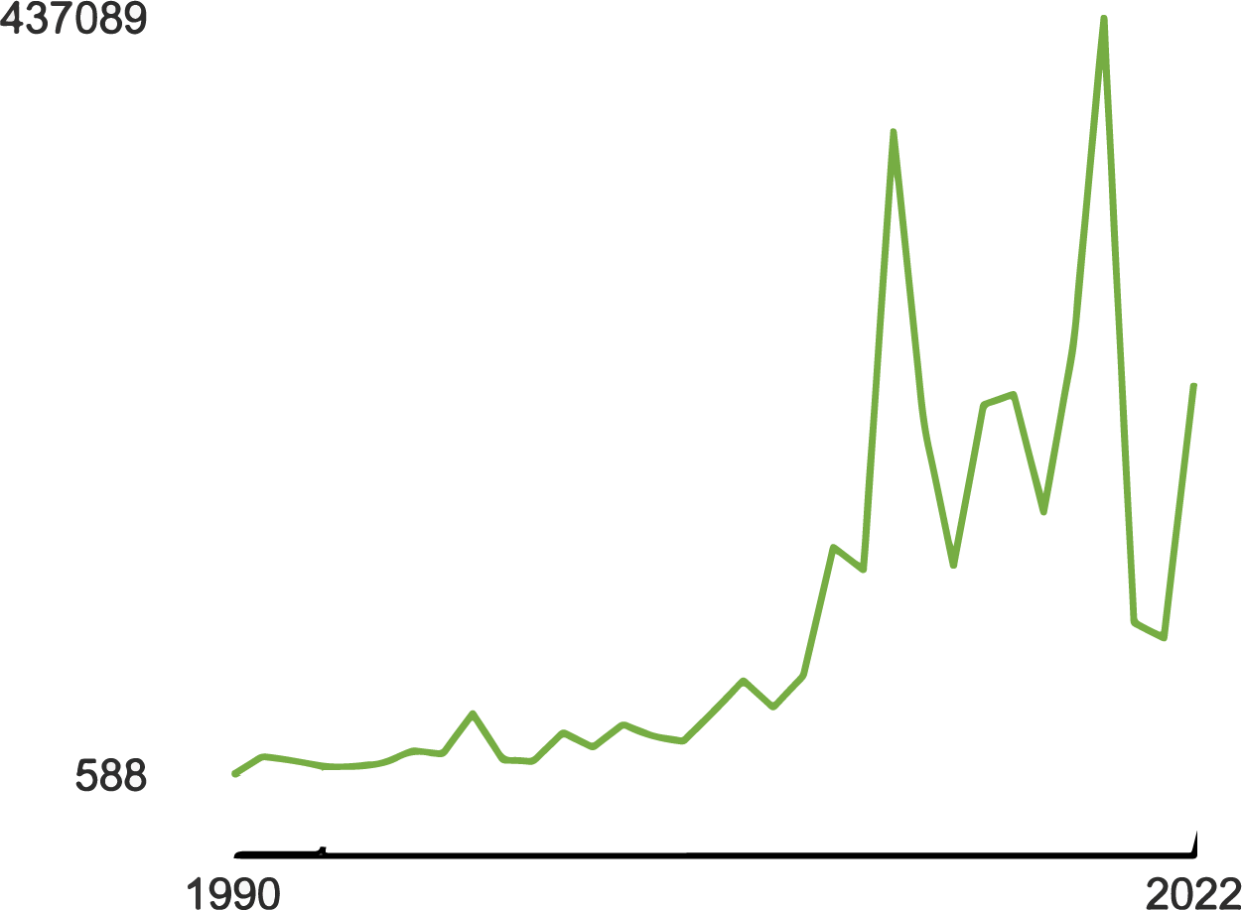

Dengue fever is common in the Philippines but remains a major public health challenge.
Why are the cases still increasing?
Dengue cases
2019
1993 – National Dengue Prevention and Control Program
Notes:
First we take a look at dengue fever in the Philippines. In case some of you are not familiar with this disease, it is transmitted through a virus that can be acquired through the bite of a mosquito. It is very common in subtropical and tropical countries like the Philippines. However, despite it being very common, it remains to be a major health concern. If we look at the number of cases from 1990 to 2022, there is an increasing trend, with the maximum number of cases occurring in 2019. But, as early as 1993 the National Dengue Prevention and Control Program has been implemented to curb its spread. Then why are the cases still increasing?

Slide 16


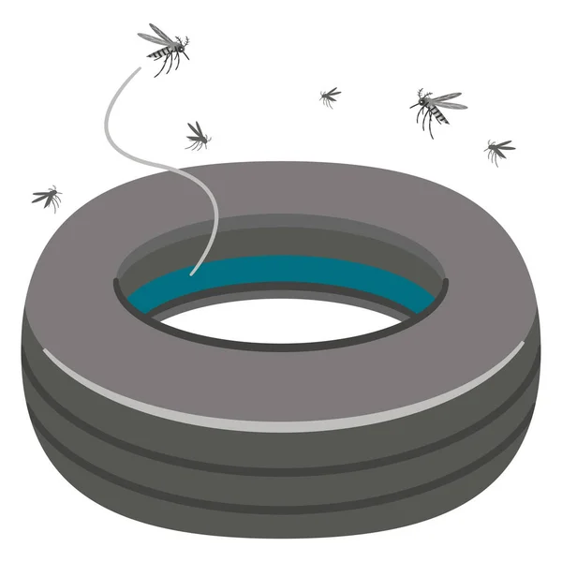
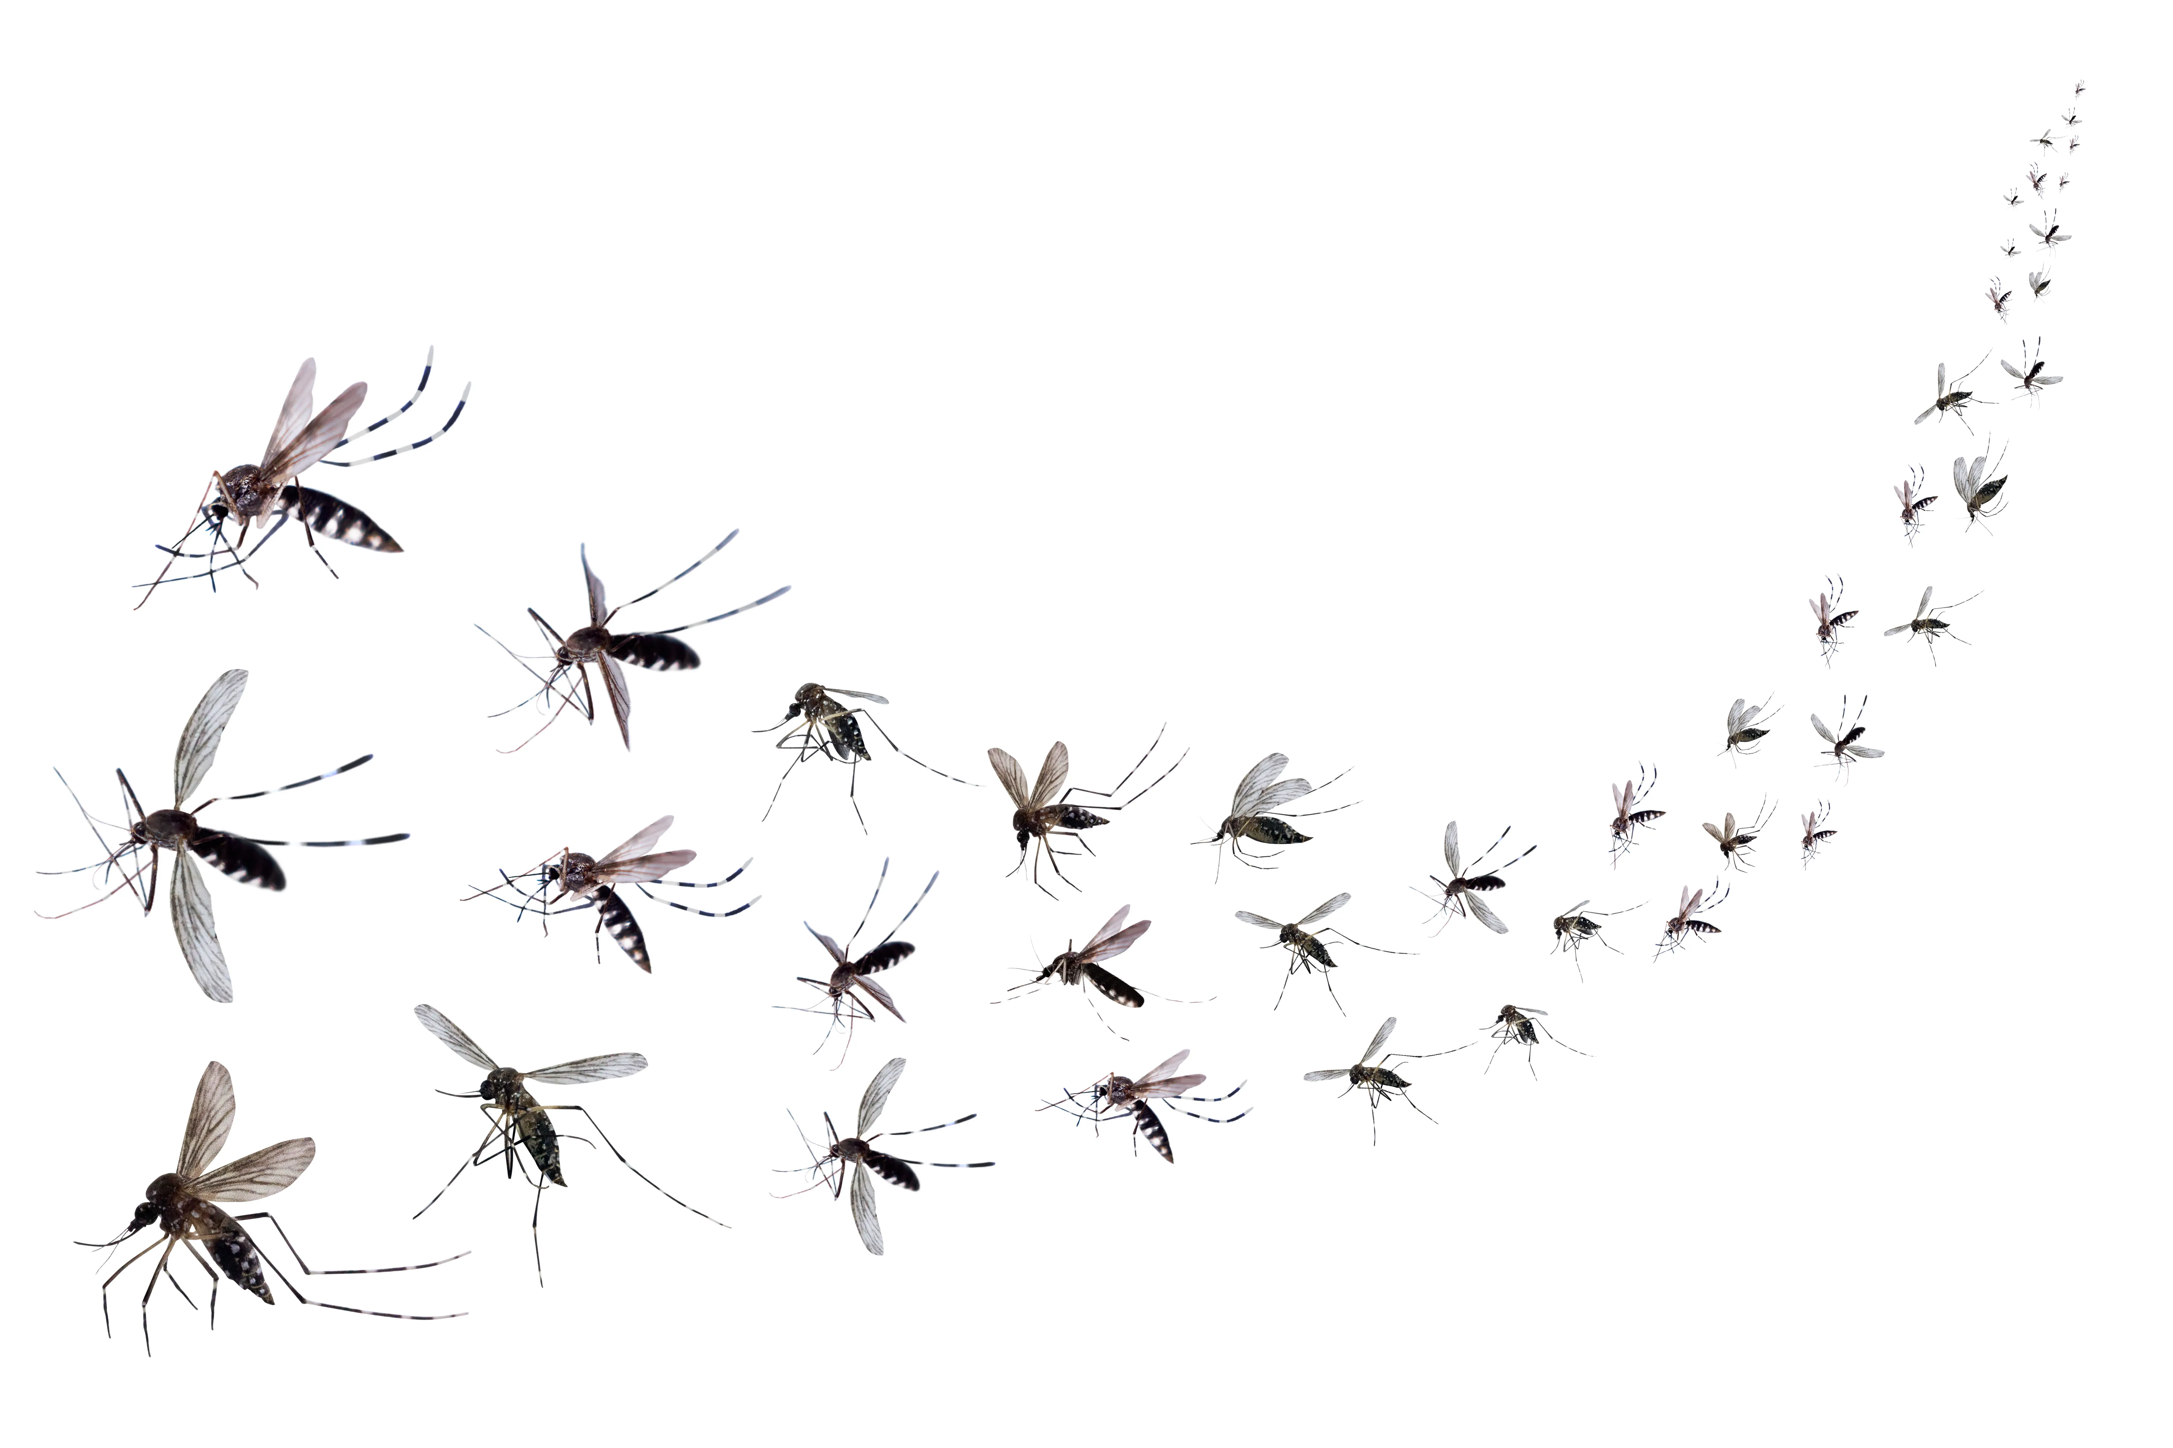

This increasing trend of cases can be largely due to weather variables.
Breeding site formation
Breeding site flushing
Mosquito reproduction, activity, and survival
Notes:
Previous studies attribute this increasing behavior of dengue incidence to weather variables, most especially rainfall and temperature. Why? Because rain can either be the cause of the creation of breeding sites of the mosquitos or it can also be the cause for breeding site flushing. On the other hand, temperature is known to be crucial to the life cycle of the mosquito, its reproduction, activity, and survival.

Slide 17
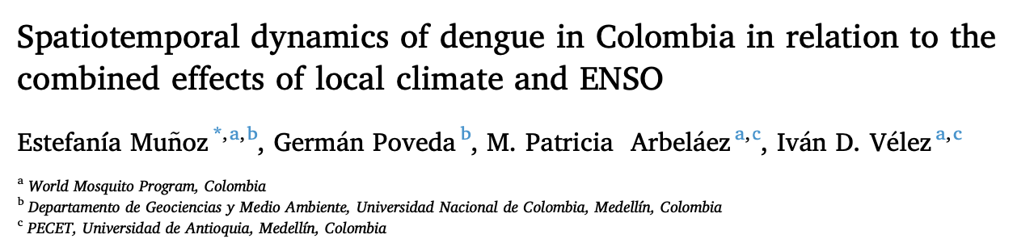


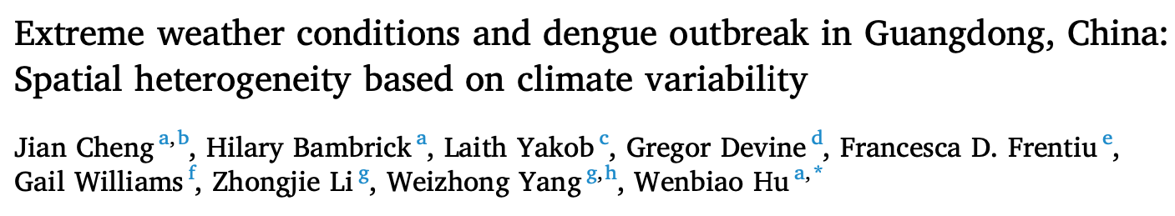
The effects of weather variables to dengue incidence have been extensively studied using different methods and with varying outcomes.
+
-
+
+
No consistency!
+
+ -
+ -
-
Mostly delayed effects
Notes:
The effects of rainfall and temperature have been extensively studied in the past years and in different locations and research setups. For example, in Colombia, temperature has a positive association with dengue cases and rainfall has a negative association. But if we look at the results in Cambodia, both temperature and rainfall have a positive relationship with dengue cases. If we further explore other literature, we can see that these relationships vary from location to location. In other words, the effects of rainfall and temperature are not consistent throughout locations.

Slide 18
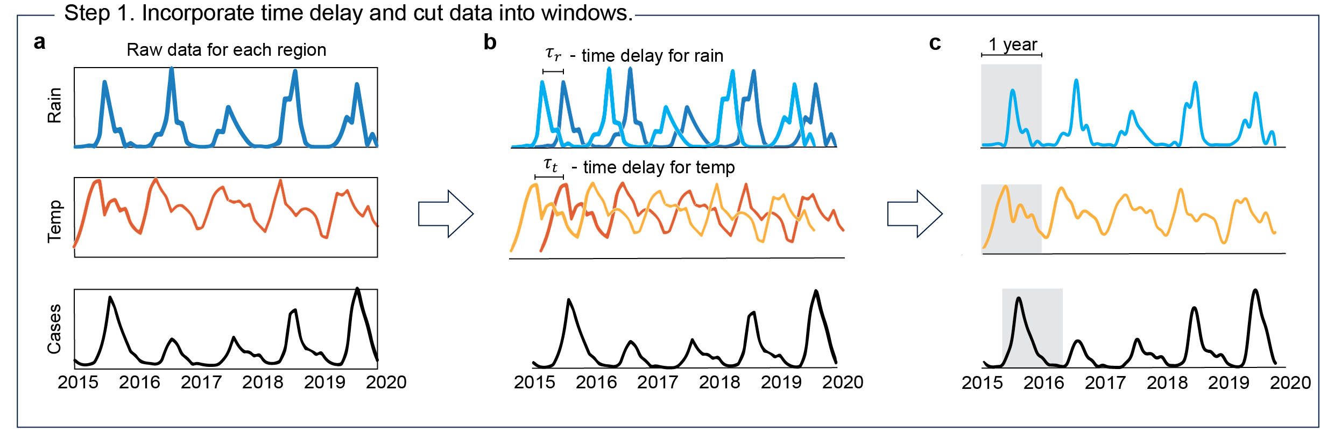
To apply GOBI, pre-processing of data is needed.
16 sets of data for
16 regions of the Philippines
Different weather patterns
Notes:
Adding these inherent delayed effects is part of the preprocessing of the data before the computation of the regulation score. We have 16 sets of data for the 16 regions of the Philippines. The reason we are doing local analysis is because the 16 regions have varying weather patterns.

Slide 19
To apply GOBI, pre-processing of data is needed.
16 sets of data for
16 regions of the Philippines
Different weather patterns
Notes:
Then, we add time delays for rain and temperature to incorporate the time delayed effects.

Slide 20
To apply GOBI, pre-processing of data is needed.
Interpolate and cut into
1-year windows.
16 sets of data for
16 regions of the Philippines
Different weather patterns
Notes:
Then, we interpolate the data for smoothing, since we need the derivative for the computation of the score. After interpolating, we cut the data into 1 year windows.

Slide 21
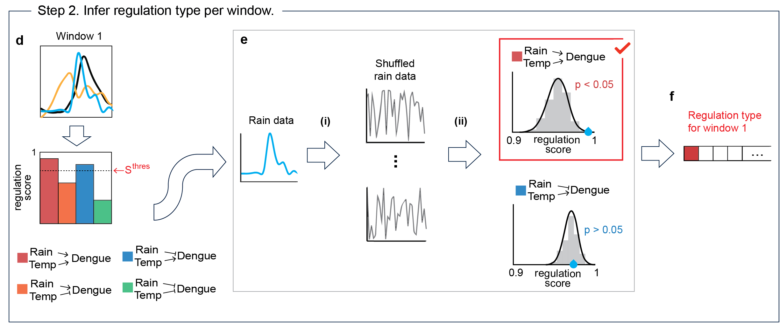
For each window, a regulation type is selected.
Notes:
Then, for each window, we compute the regulation detection function for each regulation type as shown before. Here, for noisy data, we relax the criterion to RDS greater than some threshold. So here, only the red and blure regulation type passes the threshold.

Slide 22
For each moving window, a regulation type is selected.
Notes:
Then, to further eliminate false regulations, we perform another test. We simply shuffle one of the causal variables, for example here, we shuffle the rain data many many times, compute the score for each shuffling so that we can create this distribution. Then, we compare the score from the unshuffled data to this distribution. If the p value is very small, then the regulation type passes the test. If not, then it fails. So that here in this case, the red regulation type passes. Then what if both pass? These regulation types cannot both be true at the same time, so the conflicting regulations are cancelled out, so that only regulation from temperature remains.

Slide 23

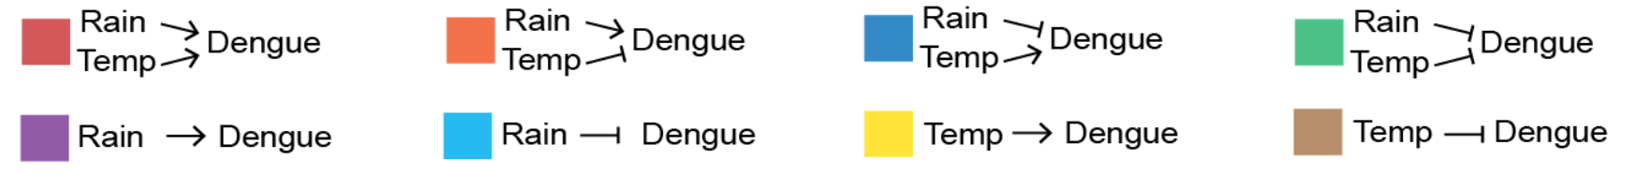
What if conflicting regulation types pass the tests?
Conflicting!

Slide 24
What if conflicting regulation types pass the tests?
Conflicting!

Slide 25
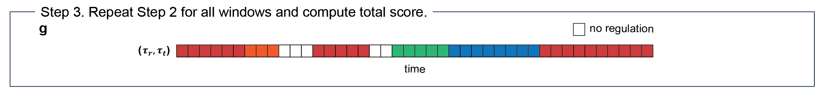
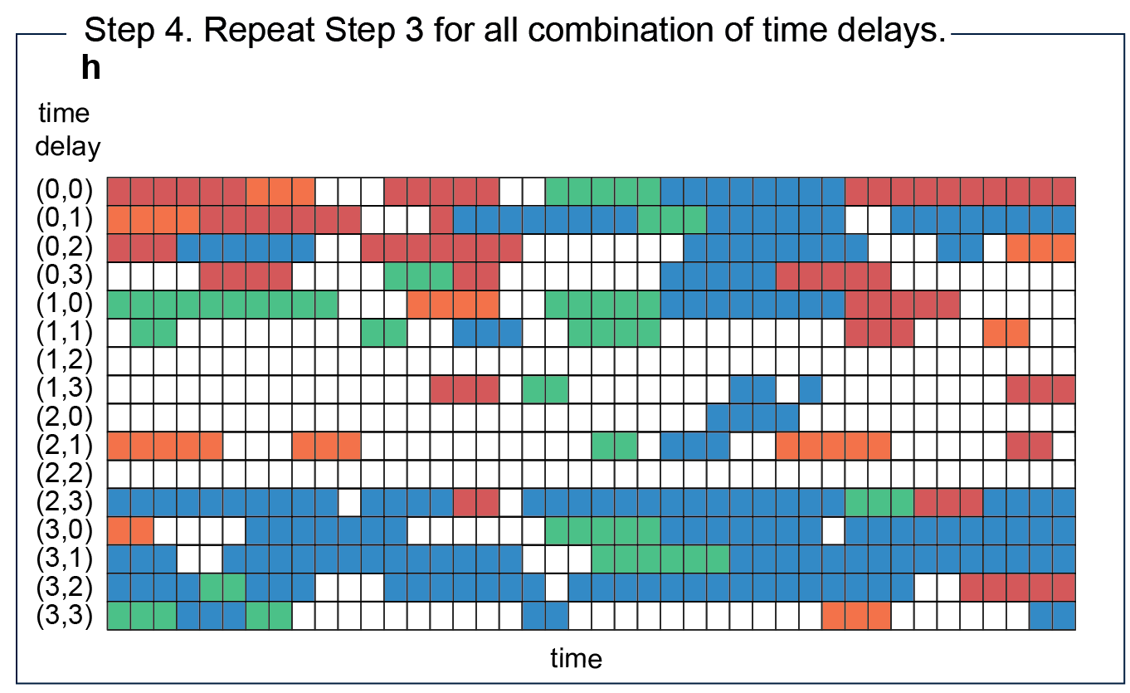
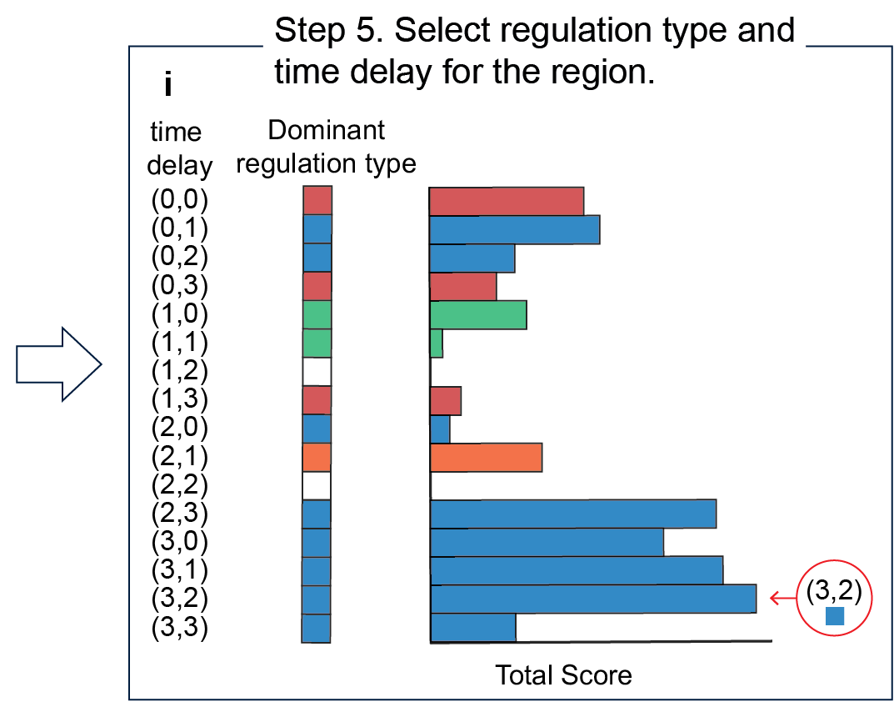
Solving the regulation scores and filtering are repeated for all time delays to select the final regulation type.
Notes:
So, solving for the regulation scores and performing the filtering tests are computed for each window so that for combinations of time delays for rain and temperature, we have this kind of heatmap. Then, we choose the dominant regulation type, in this case it is the red one. To quantify this, we add the scores of this regulation type. Then, we do this for all combinations of time delays. Then again compute the sum of the dominant regulation types per combination of time delay and finally compare them with one another. Here, the highest total score occurs at time delay (3,2) 3 months for rain and 2 months for temperature, with regulation type blue. Negative regulation from rain and positive regulation from temperature.

Slide 26
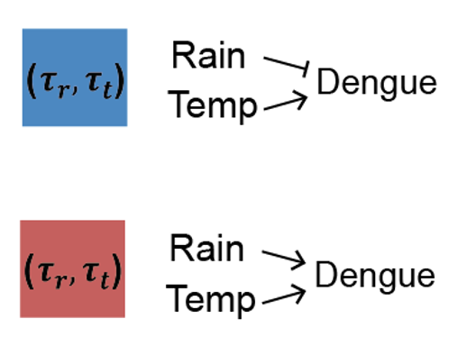
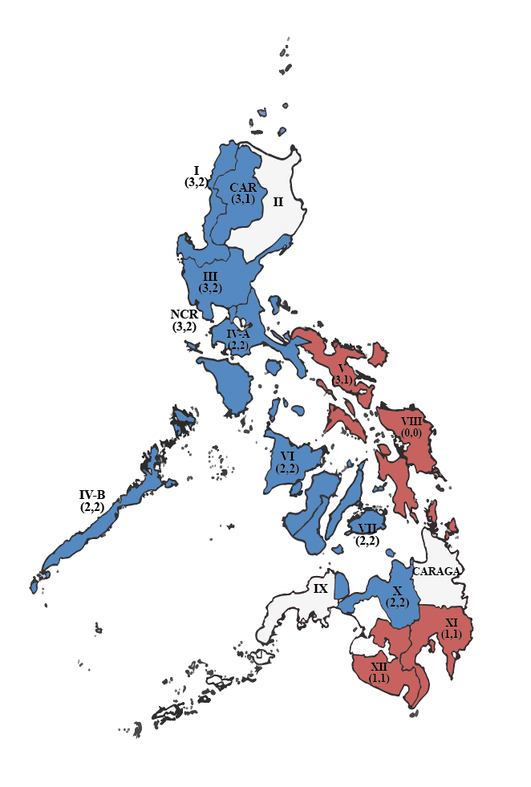
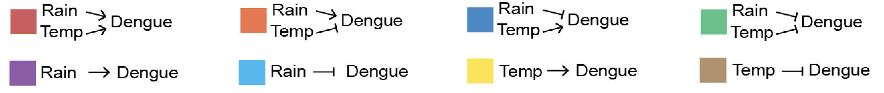
Interestingly, only 2 dominant regulation types emerge!
Regions with same regulation type are located next to each other.
Notes:
After repeating this process for all the 16 regions in the Philippines, we got very interesting results. Despite 8 possible regulation types, only 2 dominant types emerge. The red where rain and temperature both positively regulate dengue cases, and the blue where rain negatively regulates dengue and temp positively regulates dengue. And, when we plot this on the Philippine map, we get this color-coded map. The regions with the same regulation types are located next to each other. Why? To find the reason for this, we can look back at the raw data.

Slide 27
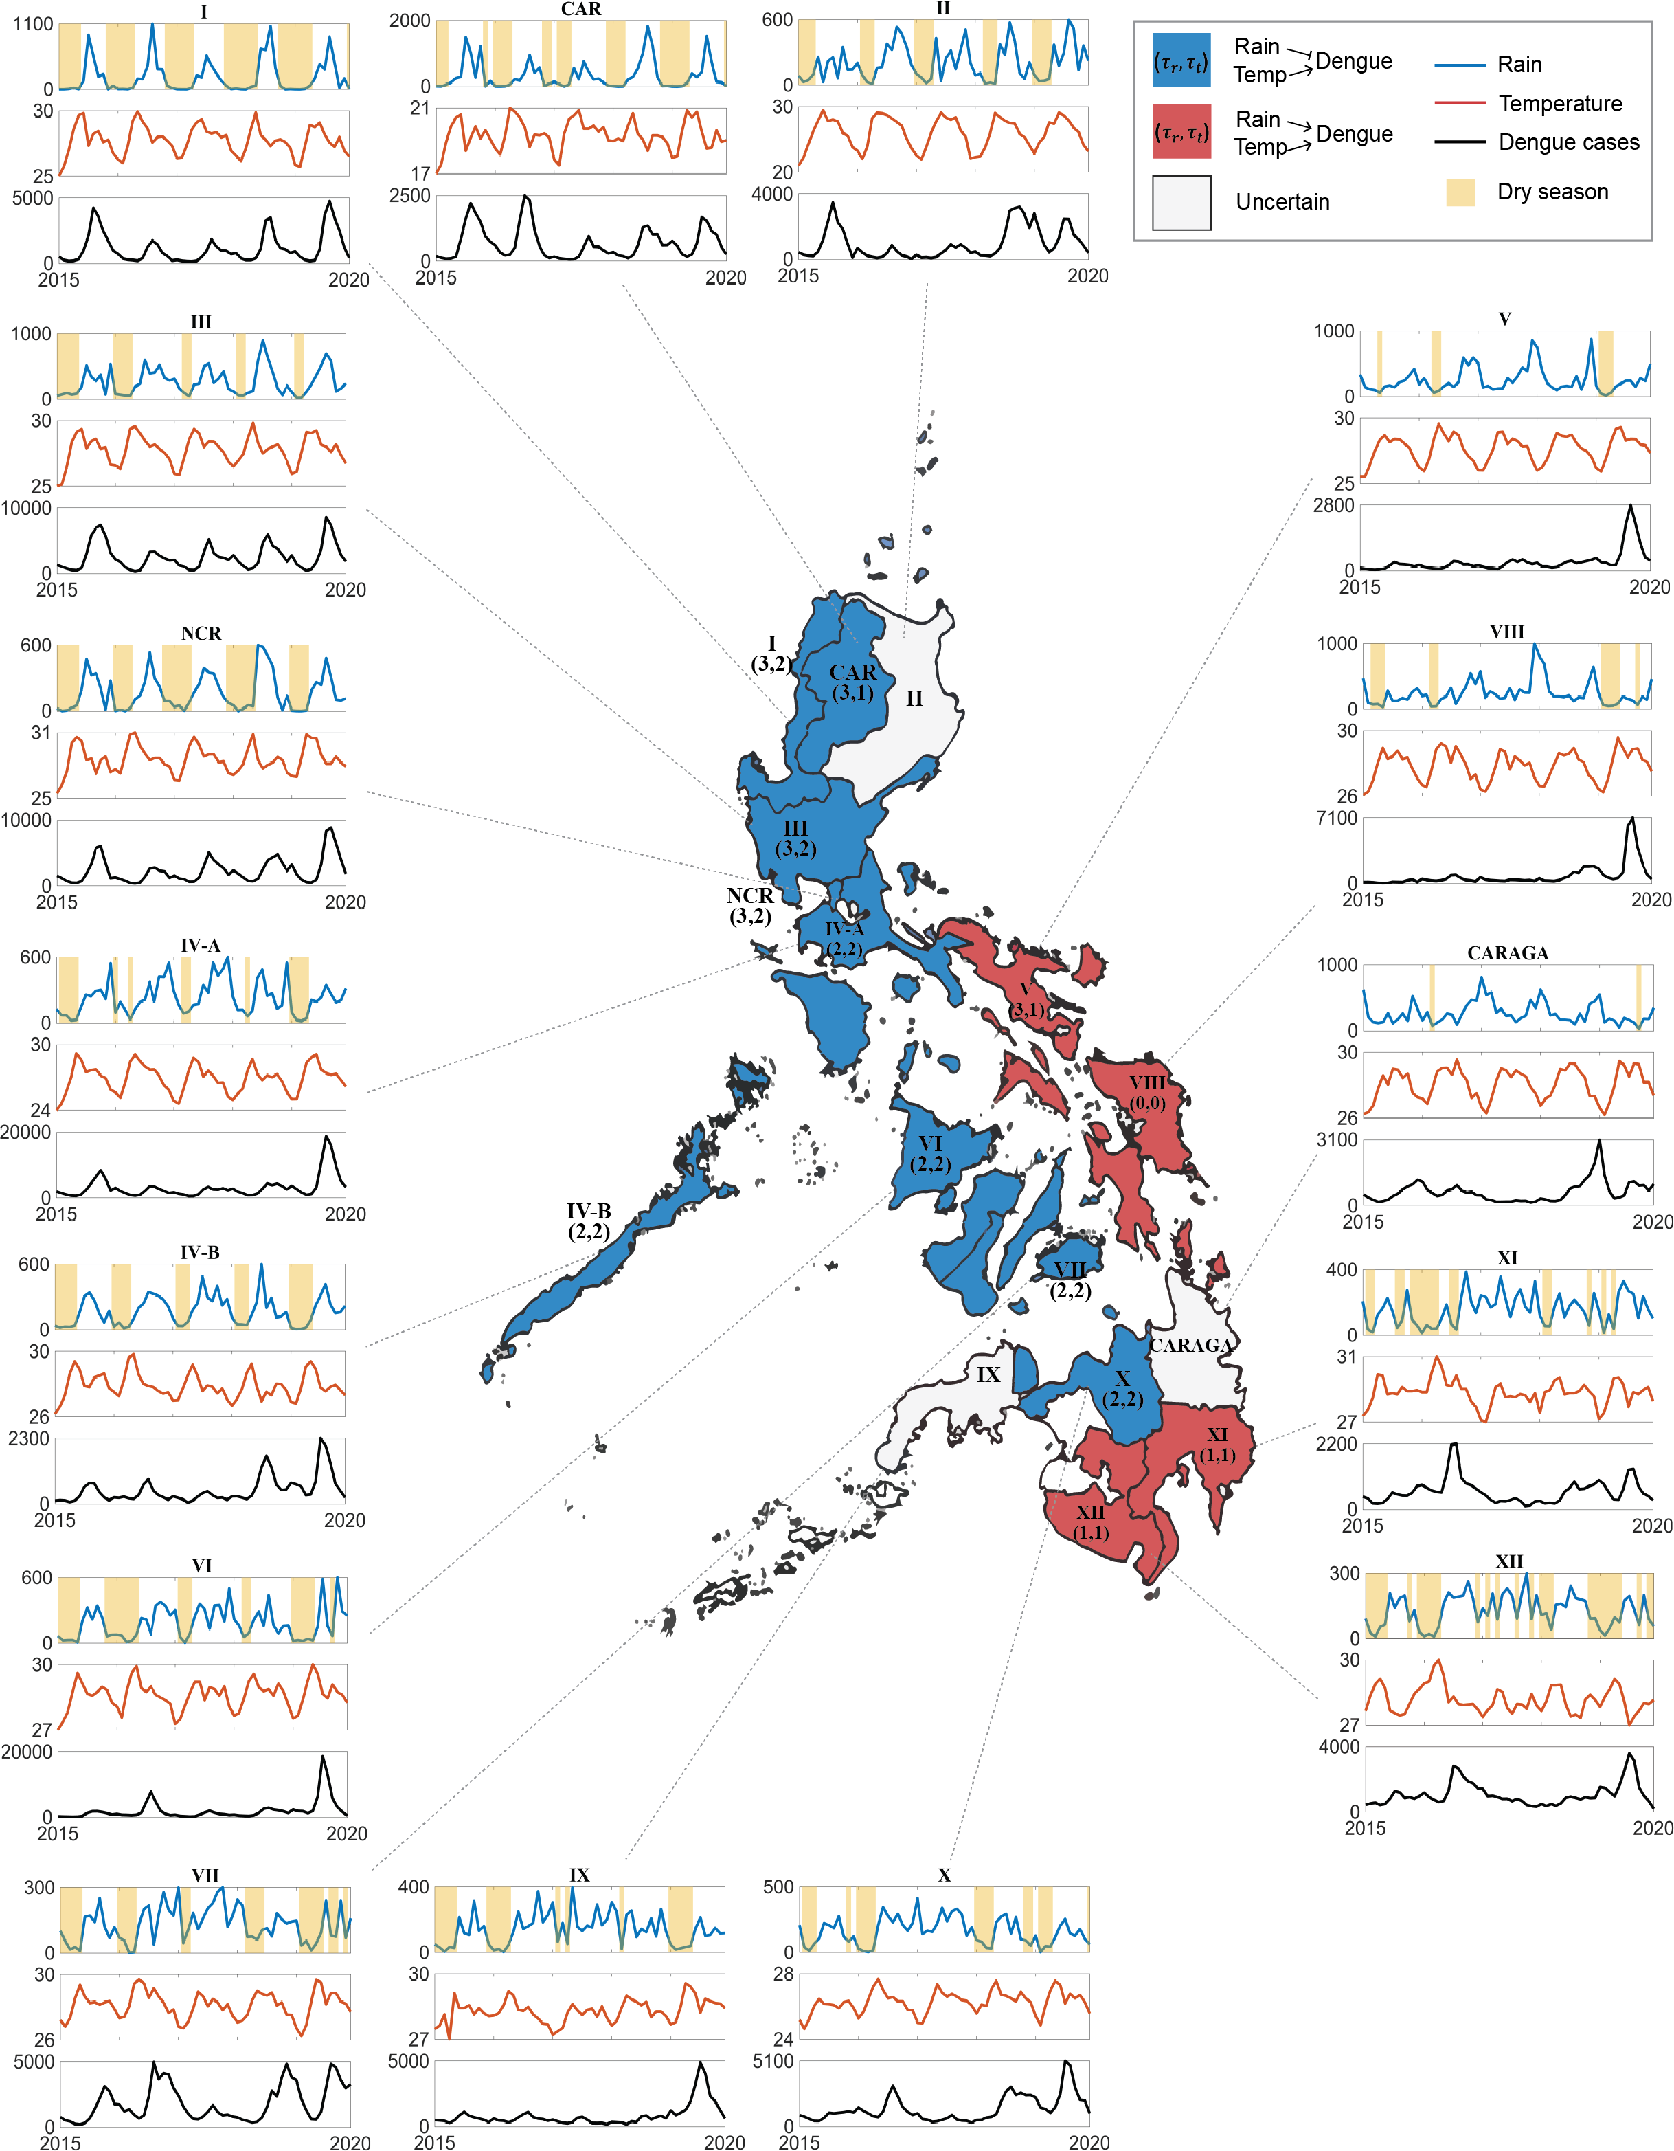
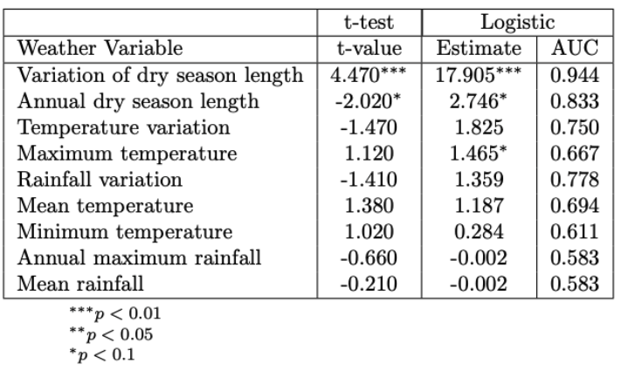
The 2 dominant regulation types are distinguished by dry season length variability.

Slide 28
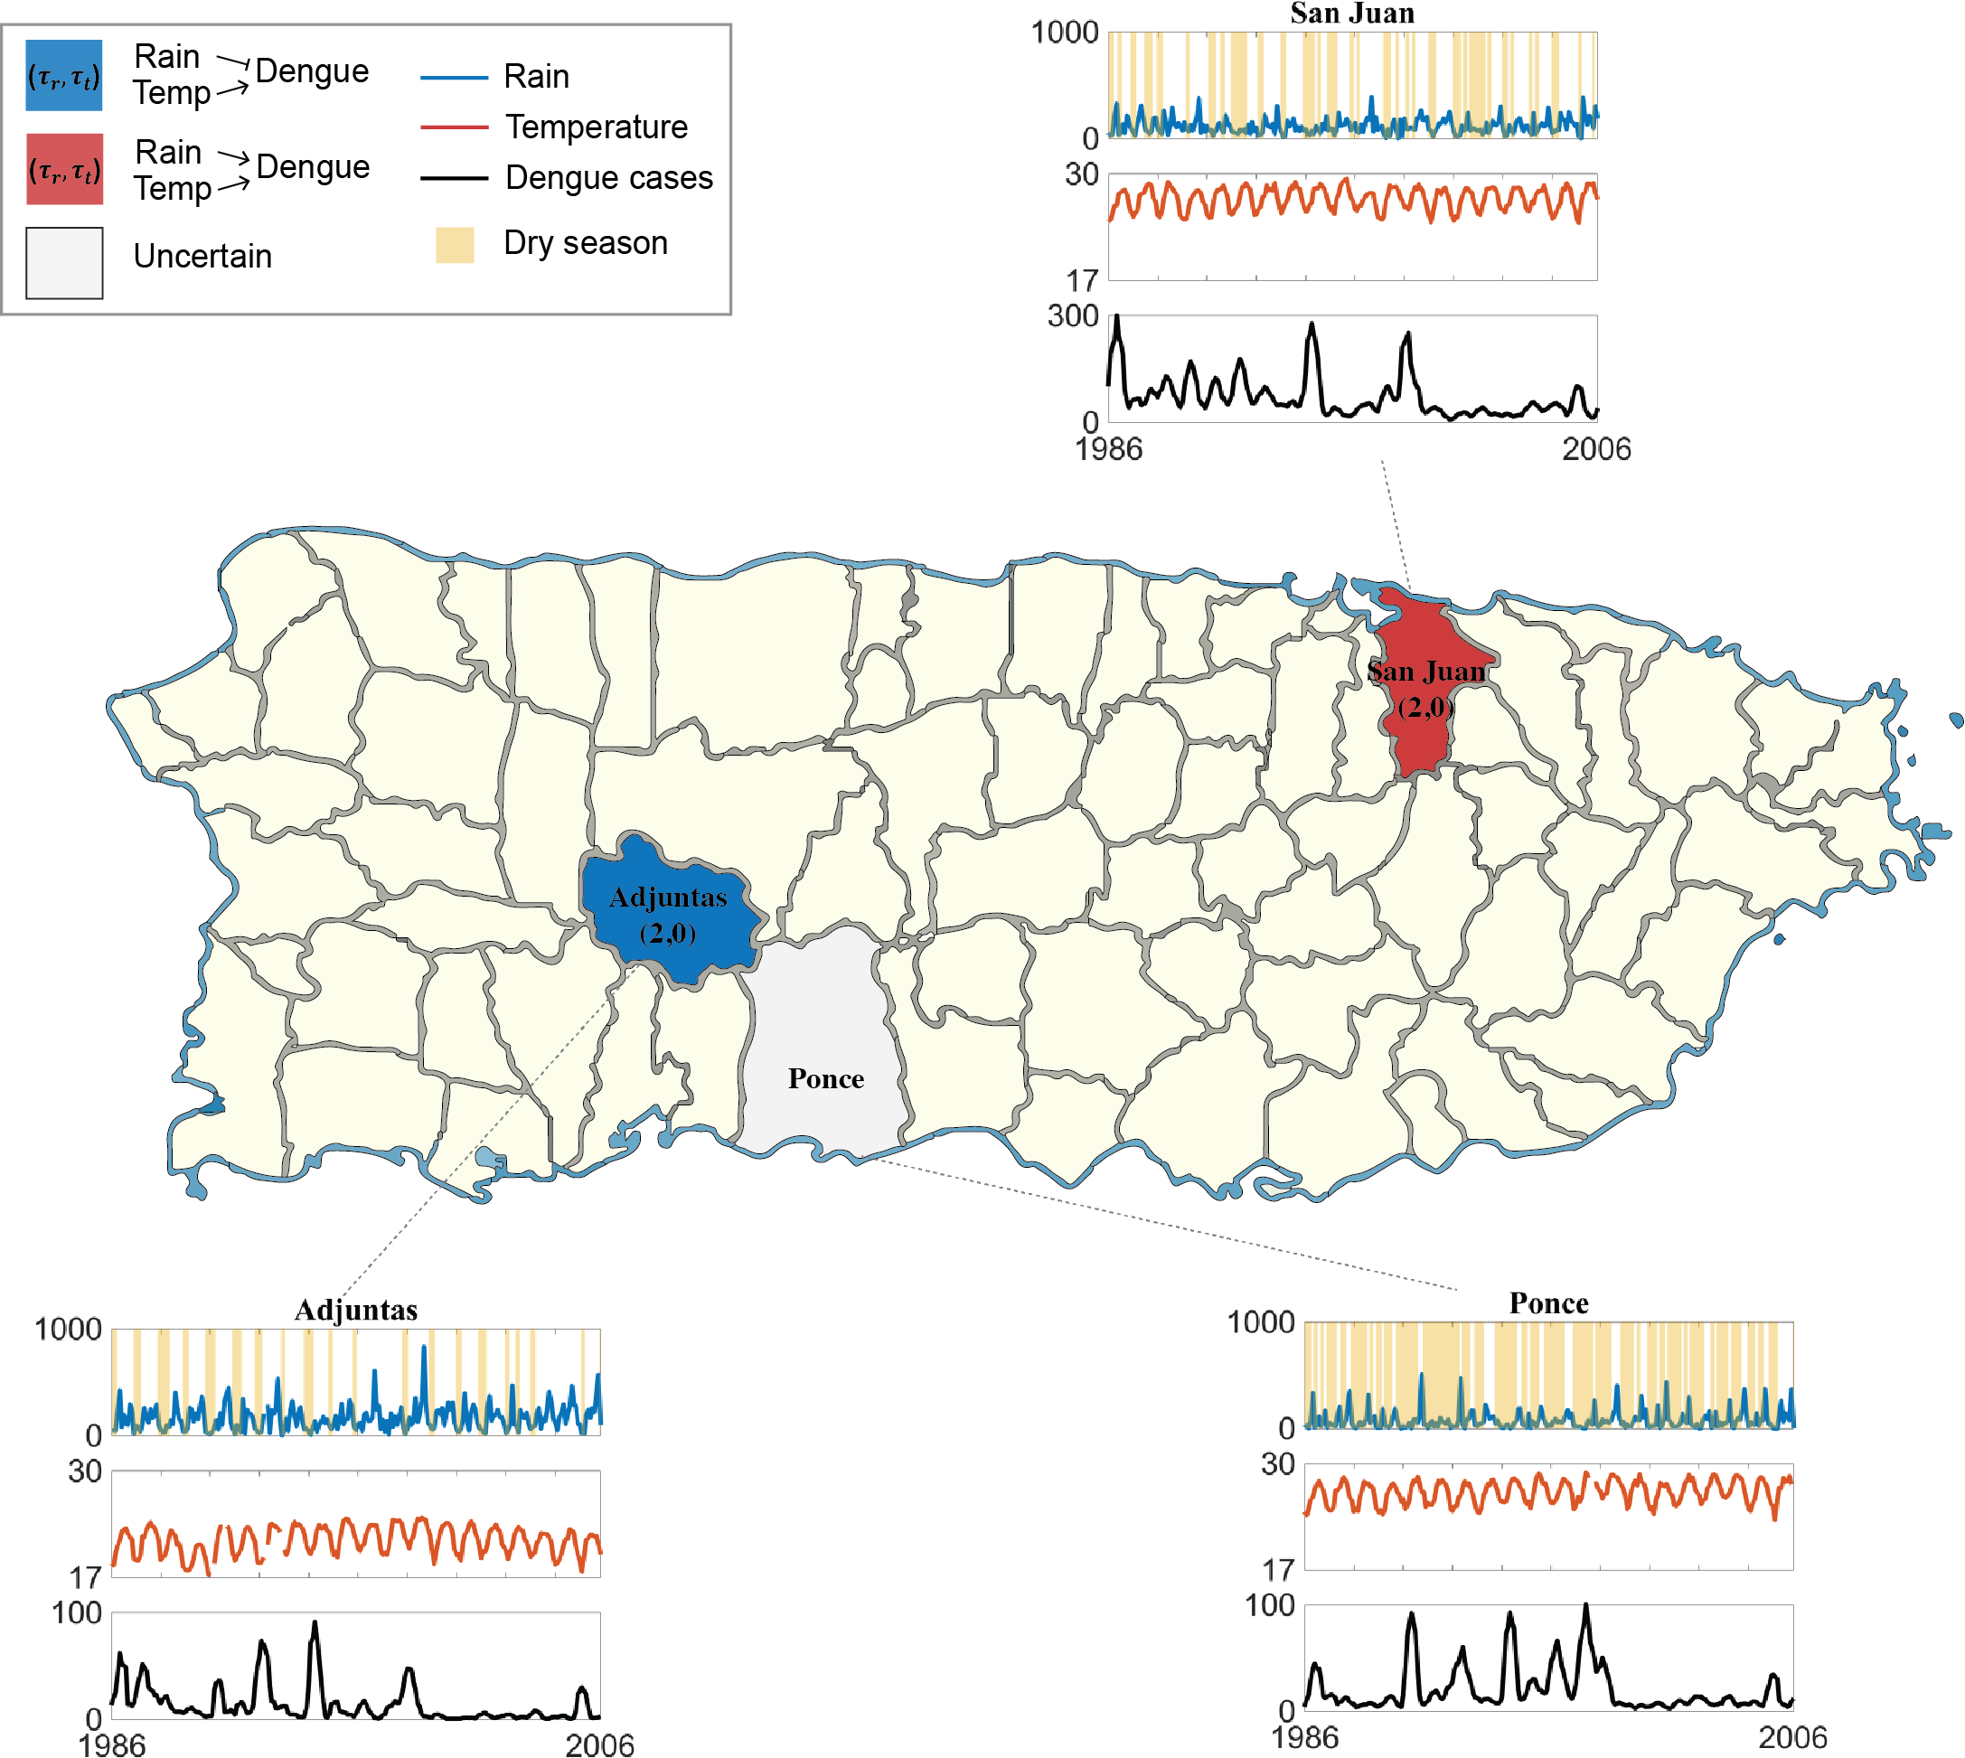
We get similar results after applying the same framework to data of Puerto Rico.
High variability in dry season length
Low variability in dry season length

Slide 29


Our analysis identifies the presence of dry season length variability as an additional indicator of dengue incidence.
Previous studies
Method: correlation analysis, classical causation methods
This study
Method: GOBI (with delay)
R
R
R
R
D
D
D
D
T
OR
T
Dry season length variability
T
T
Notes:
So we say that our analysis identifies dry season as an additional indicator of dengue incidence, which has not been considered in previous studies. In previous studies using correlation methods and classical causation detection methods, the usual conclusion is this: In some cases, as rain and temperature increase, dengue cases also increase but in some cases, when rain and temperature increase, dengue cases decrease. However in our analysis, we used the presence of clear dry season as a unifying criterion for rainfall, temperature, and dengue cases relationship. That is, when there is no clear dry season, as rain and temperature increase, dengue cases increase. However, when there is clear dry season, as rain and temperature increase, the dengue cases decrease.

